Slide 1
N4 SOLID TEAM
WEEK 1 REPORT

Slide 2
ACHIEVEMENTS
Introduction and Orientation of new members
Planning of the next static test
Fabrication of liner
Preparation of Specimen for tensile strength test

Slide 3
1. Introduction and Orientation of new members
- A brief overview of the solid propulsion team was done and new members were familiarized with the team’s workflow
- New roles were assigned to different members to ensure efficiency and accountability

Slide 4
Team member | Role
Nephat Gakuya | Team leader
Franklin | Ignition
Collins Kinyua | Ignition
Lenet | Log activities and pictures
Nelly | Purchasing
Ryan Wamburu | Documentation
Brian Ikiara | Inventory

Slide 5
2. Planning of the next static test
A detailed roadmap of our workflow was drafted and a timeline of when we were going to carry out the static test was discussed.
SUMMARY OF THE TIMELINE:
WEEK 1-2: Failure analysis, Liner Fabrication and Component Fabrication
WEEK 3: Grain cooking, Test stand refurbishment and Motor pre-assembly
WEEK 4: Final motor assembly and Static test

Slide 6
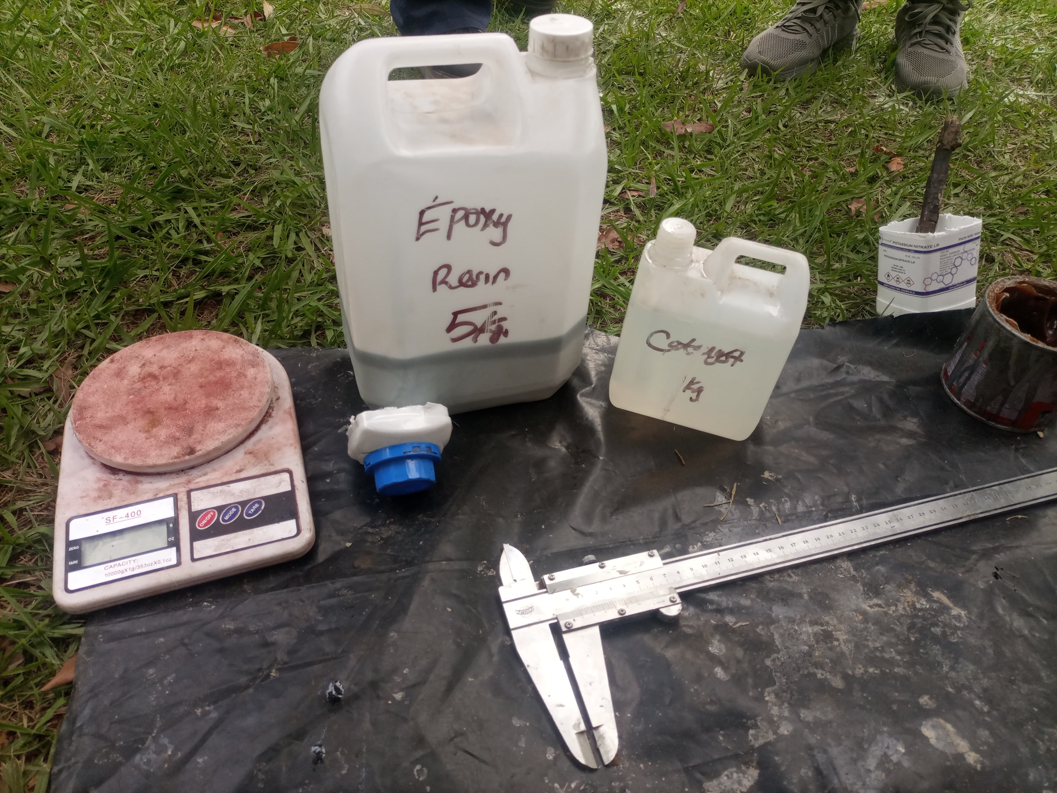
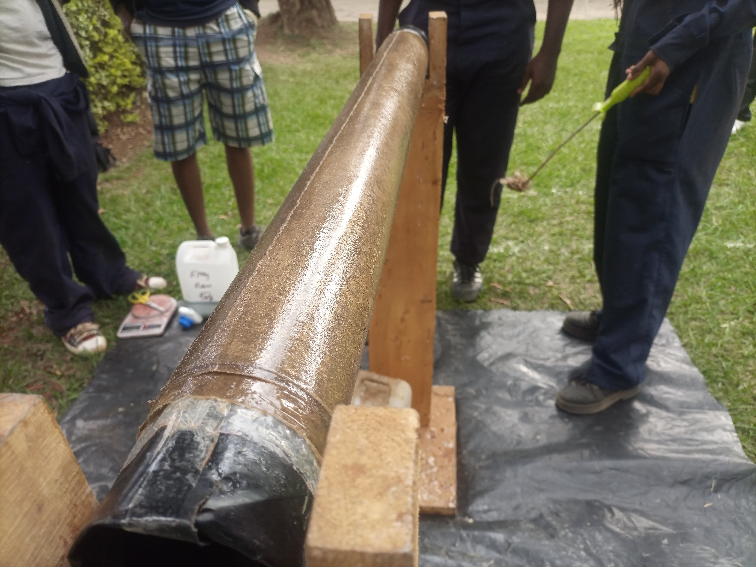
3. Liner Fabrication
Hardener and Epoxy mixed with a 1: 50 ratio Liner left to cure on the mandrel

Slide 7
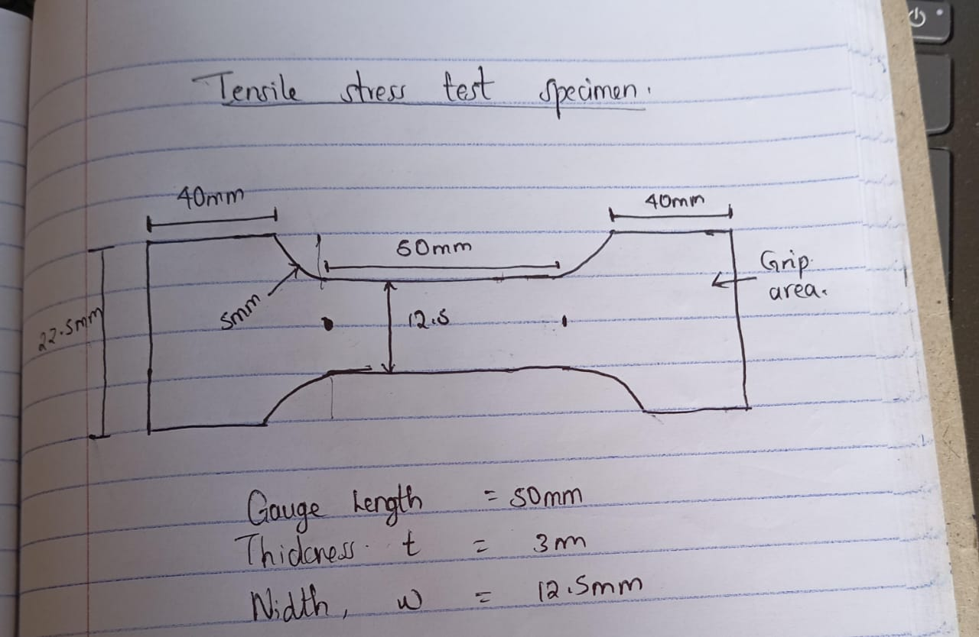
4. Preparation of Specimen for tensile strength test
A specimen based on ASTM standards was sketched for the tensile strength test which will be done during the second week

Slide 8
Challenges Encountered
1. Delayed machining of bulk heads due to workshop occupation
-The workshop was in use by the internal attachment students

Slide 9
THIS WEEK’S OBJECTIVES: 1. Finalize the error analysis from previous static test 2. Perform mechanical tests i.e. Tensile Strength test 3. Machining of new bulk heads 4. Grain cooking

Slide 10


